Slide 1
IoE Chapter 6 Using Apache Storm for Data Analytics
Dr. Vinayak Ashok Bharadi

Slide 2
Analytics
Analytics is about finding meaningful patterns in data. Real-time analytics is about building patterns by analyzing events as they occur. Traditional analytics is based on offline analysis of historical data, whereas real-time analytics involves comparing current events with historical patterns in real time, to detect problems or opportunities.
Big data technologies enable us to process data in large volumes as well as high velocity. Technologies like Hadoop makes it possible to run batch-oriented analytics over terabytes of data.

Slide 3
What is Real-time Analytics?
Real-time analytics is the use of all available enterprise data and resources, when they are needed. It consists of dynamic analysis and reporting, based on the data entered into a system, it takes less than one minute before the actual time of use.
Real-time analytics is also known as real-time data analytics, real-time data integration, and real-time intelligence.

Slide 4
Similarly, technologies like Apache Storm enable us to develop run-time analytics solutions which can process thousands of messages per second.
Apache Storm helps us address the challenges of developing a reliable distributed solution such that our development effort is focused on business logic rather than implementing a distributed platform.

Slide 5
Significance of Real-time Analytics
It’s importance in various domains has proved that the application brings quicker solutions. Whether it is banking, retail or telecommunication, real-time analytics has its way around.
Detection of fraud transaction - Real-time analytics enables to detect the location and longitude. If the locations of both the transactions do not match, then there is definitely a grave issue.
Trend Generation – Social NW- Based on a user’s tweets, they source the most trending and talked about topics, and post it on the page about what’s trending.
Brands like twitter, flipboard, OOYALA, Loggly, wego have been the adopters of storm extensively for trending topics, custom magazine feeds, real-time video analytics, and compare and display real-time prices.

Slide 6
Business Challenges
Traditionally, in an incoming service request we avoid additional processing. For example the processing which is required to look for patterns and statistics.
Especially, when rate of the incoming data stream is of the order of thousands messages per second because any delay introduced by the additional processing can result in bottleneck in service delivery. Such delays can trickle down to impact on quality of service.

Slide 7
Real Time Processing issue
For example, in telecom, a service provider may have complete details of each service taken by each of its subscribers. However, a service provider may have subscribers in order of 1,000,000s and analyzing service problems in real-time may require capability of processing 1,000s of messages per second (considering the aggregate traffic generated by these subscribers during a busy hour).
Moreover, the system may also have to analyze performance data reported from the network infrastructure itself.
To handle such a high rate of incoming data, solution would typically require distributed computing and high availability. Traditional solutions for building these clusters and managing them are expansive and require good amount of maintenance effort.
Besides, a traditional distributed solution has its own set of challenges like trading off between reliability and performance.

Slide 8
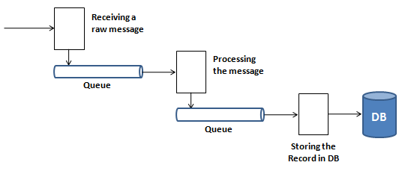
Traditional Approaches and its Disadvantages
Traditionally, real time processing is done using queues and workers. For example,
first there is a worker to receive messages and to place it in a queue.
Second worker listens to the queue, picks up the message, parses it, processes it and places the processed message in a second queue.
Next worker picks up the processed message from the second queue and logs it in database

Slide 9
Disadvantages of Conventional System
It needs to be made sure that all queues and workers stay up, all the time.
when application is required to scale to support high throughput, then these queues and workers are required to be distributed. Distributing the queues, requires exchange of state across all the nodes within the cluster and there is a trade-off between reliability and performance of the distributed queues
Distributed queues and fault-tolerance are complex functions. Implementing life cycle management of the queues (setting up, monitoring, cleanup, setting-up again) involves significant development time
Especially, fault tolerance and high-availability require good amount of development time and their maintenance is also quite expensive. Usually, these functions cannot be tested in lab environment because problems appear only in high load conditions. Moreover, when these problems occur in field, then one does not get debug-traces for troubleshooting.

Slide 10
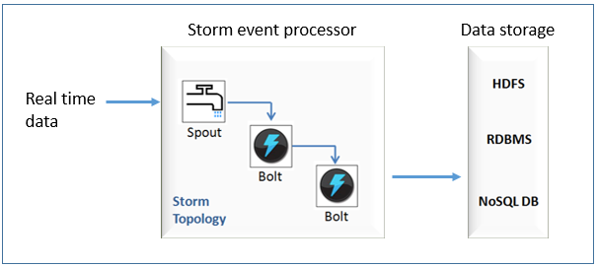
Apache Storm
Apache storm is a framework that facilitates distributed real-time processing.
Similarly, during real-time processing of a stream of data by Storm, a spout reads the incoming data stream and feeds it to a processing unit called bolt.
Bolt performs specified business logic on the data stream and passes on the processed stream to the next bolt.
Bolts and interconnections between them are termed as storm topology. There can be one or more topologies in a single system, which can be connected through message queues.

Slide 11
Each spout and bolt can have one or more instances. These instances can be spread throughout the storm cluster. Communication among these distributed spouts and bolts is transparent to a developer.
The communication is seamlessly managed by the storm framework itself. Storm is open-source and free.
To use Storm, a developer is primarily required to provide implementation of execute() method of each bolt. Following features come out-of-the-box with Apache Storm:
Distributed framework (scalable)
Fault tolerant (highly available)
Guarantees no data loss (reliable)
Storm topology can be easily integrated with different data storage options, like HDFS, traditional RDBMS, and a NoSQL database.

Slide 12
Real-Time Analytics With Network Data – Case Study
This section explains Apache Storm based real-time analytics solution, using an example of a telecom service provider. In the network of a telecom service provider, there can be different sources of incoming data, like:
Stream of data generated due to use of services by subscribers
Performance data of access network, as reported by network probes
Data related with new subscription orders, activation and terminate orders

Slide 13
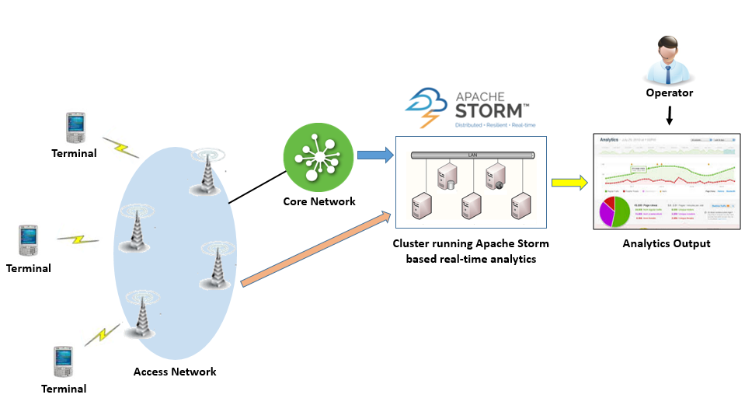

Slide 14
A single storm topology running inside a cluster can listen to all different kinds of incoming data.
The storm topology may have different spouts for each source of input. Spouts are followed by Bolts which take care of processing the incoming data and calculate statistics which captures information across services, regarding the quality of service provided to the subscribers, performance of network elements and new received orders.
The processed statistics are stored in a NoSQL database for future reference and are also used to plot several services-related real-time charts.

Slide 15
The analytics can be used to device a solution that can automatically detect under-performing network elements and reconfigure the network such that it is more balanced with respect to its utilization.
Similarly, network coverage related issues can be tracked and input can be provided to network planning, in real-time. Also, the analytics charts can be monitored by proactive call center operators, who can reach out to subscribers (who are facing service related issues) with attractive offers to replace their service plan or terminal which suits better to their usage pattern.

Slide 16
Such seamless handling of network-related issues and proactive customer support can be instrumental in improving user experience manifold.
It can help a telecom service provider in building a competitive advantage in the market, by maintaining a real-time focus on customer experience.

Slide 17
Apache Storm provides a stable and robust framework for a real-time analytics solution. The framework provides base classes for spouts and bolts.
Spout class inherits class BaseRichSpout and bolt class inherits BaseRichBolt. One is required to just implement nextTuple() method in spout class such that it reads data from an incoming data stream and emits it inside the storm topology. Similarly, one has to write the implementation of execute() method in bolt class to provide business logic to process the data passed on by the connected spout.
Multiple spouts can be defined for different sources of data. For example, one spout for tapping into charging data, second to tap performance data from the access network and third spout for accessing data from incoming order requests.

Slide 18
Benefits of using Storm
Allows real-time stream processing.
Scalability – where throughput rates of even one million 100 byte messages per second per node can be achieved.
Low latency – Storm performs data refresh and end-to-end delivery response in seconds or minutes depends upon the problem.
Reliable – Storm guarantees that each unit of data (tuple) will be processed at least once or exactly once. Messages are only replayed when there are failures.
Easy to operate – standard configurations are suitable for production on day one. Once deployed, Storm is easy to operate.
Fault-tolerant: The ability of fault-tolerant is extremely important for storm as it processes massive data all time and should not be interrupted by a minimal failure, such as hardware fail in nodes of the storm cluster. Storm can redeploy tasks when it is necessary.
Data guarantee: No data loss is one of the essential requirements for a data processing
system. The risk of losing data would not be accepted in the use of most fields, especially for those ask for accurate results. Storm makes sure that all the data would be processed as they are designed during their processing in the topology.
Ease of use in deploying and operating the system.
Support for multiple programming languages.
Fraud can be detected the moment it happens and proper measures can be taken to limit the damage.

Slide 19
Similarities among Hadoop and Storm
All three are open-source processing frameworks
All these frameworks can be used for Business Intelligence and Big Data Analytics
Each of these frameworks provides fault tolerance and scalability.
Both are distributed.
These frameworks are preferred choices for Big Data Developers due to their simple installation methods.
Hadoop and Storm have implementation in JVM based programming languages – Java and Clojure respectively.

Slide 20
Apache Storm vs Hadoop
Storm | Hadoop
Real-time stream processing | Batch processing
Master/Slave architecture with ZooKeeper based coordination. The master node is called as nimbus and slaves are supervisors. | Master-slave architecture with/without ZooKeeper based coordination. Master node is job tracker and slave node is task tracker.
Stateless | Stateful
Storm topology runs until shutdown by the user or an unexpected unrecoverable failure. | MapReduce jobs are executed in a sequential order and completed eventually.
A Storm streaming process can access tens of thousands messages per second on cluster. | Hadoop Distributed File System (HDFS) uses MapReduce framework to process the vast amount of data that takes minutes or hours.

Slide 21
Use Cases of Apache Storm
Twitter
Storm powers Twitter’s publisher analytics product, processing every tweet and click that happens on Twitter to provide analytics for Twitter’s publisher partners.
Storm integrates with the rest of Twitter’s infrastructure, including Cassandra, the Kestrel infrastructure, and Mesos.
Many other projects are underway using Storm, including projects in the areas of revenue optimization, anti-spam, and content discovery.
Wego
Wego is a travel metasearch engine located in Singapore. Travel related data comes from many sources all over the world with different timing. Storm helps Wego to search real-time data, resolves concurrency issues and find the best match for the end-user.

Slide 22
Yahoo
Yahoo! is developing a next generation platform that enables the convergence of big-data and low-latency processing. While Hadoop is our primary technology for batch processing, Storm empowers stream/micro-batch processing of user events, content feeds, and application logs.
NaviSite
Navsite is using Apache Storm as part of their server event log monitoring & auditing system. The log messages from thousands of servers are sent to RabbitMQ cluster and Storm is used to compare each message with a set of regular expressions. If there is a match, then the message is sent to a bolt that stores data in MongoDB. At the moment, 5-10k messages per second are being handled, however the existing RabbitMQ + Storm clusters have been tested up to about 50k per second.

Slide 23
Conclusion
Apache Storm is a collection of spouts and bolts (interconnected with each other) which is referred to as storm topology.
Business logic to process the incoming stream of data is embedded within this topology.
Storm framework distributes this topology across different nodes of the cluster and ensures reliability along with high throughput (off-the-shelf). This way development remains focused on the business logic of the data processing.

Slide 24
References
https://hsc.com/Blog/Real-Time-Analytics-with-Apache-Storm
Apache Software Foundation , ìRationale of using Apache Storm, https://storm.apache.org/documentation/Rationale.html, 2014
Apache Software Foundation , ìStorm documentation - Apache Storm Tutorial, https://storm.apache.org/documentation/Tutorial.html, 2014
Nathan Marz, History of Apache Storm and lessons learned, http://nathanmarz.com/blog/history-of-apache-storm-and-lessons-learned.html, Thoughts from the red planet, 6th October 2014.

